Slide 1
Animal Senses

Slide 2
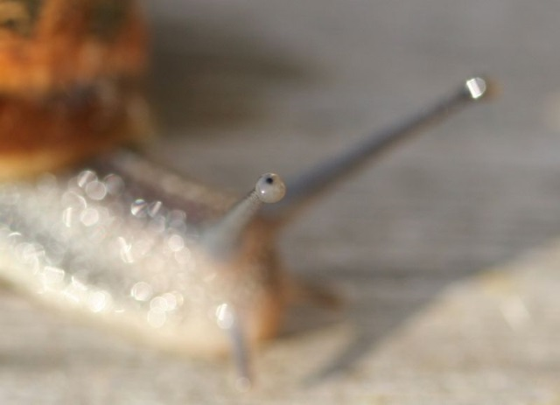
Photoreceptors
Vary from simple light/dark sensors in simple animals (e.g. worms) to complex organs in advanced animals.
Wavelengths detected can vary from ultra-violet to red. Bees can see UV. Goldfish can see infra-red. Birds see red well.

Slide 3
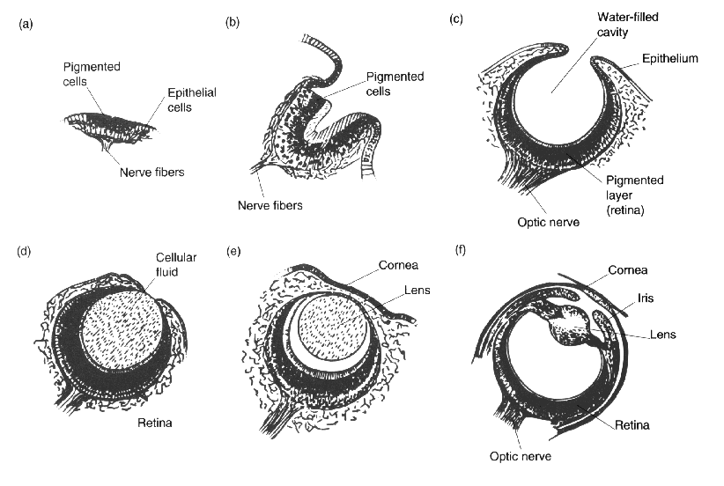
A range of mollusc eyes

Slide 4
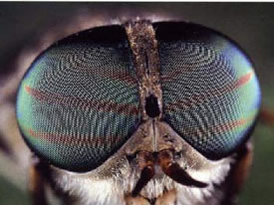
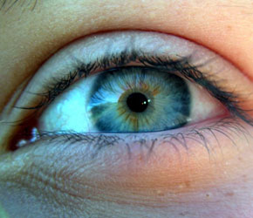
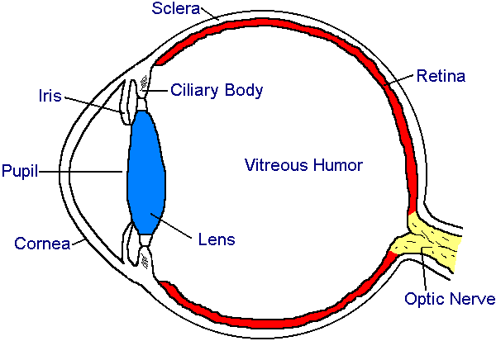
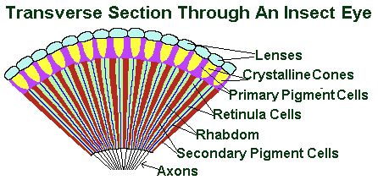
Comparing eyes

Slide 5
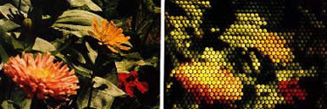

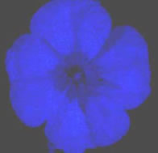
Comparison of human and insect vision
Human insect

Slide 6
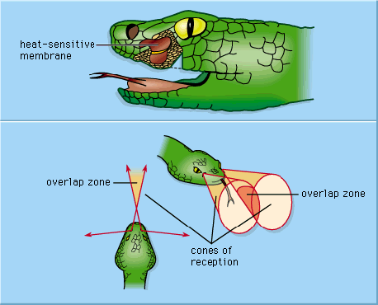
Thermoreceptors
Some snakes have infra-red sensitive pits that allow them to detect prey in the dark.

Slide 7
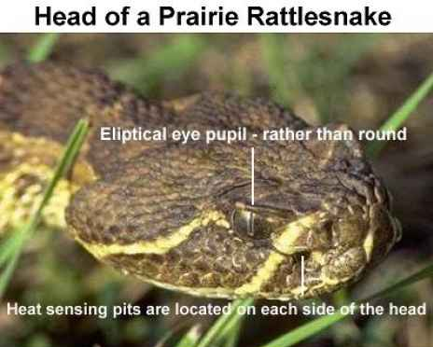

Slide 8
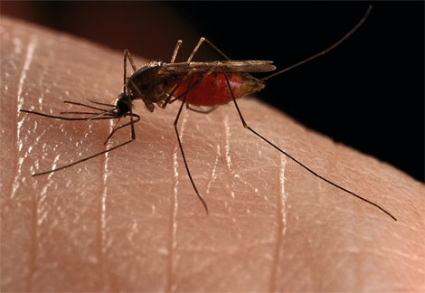
Humans can detect warmth with skin sensors
Mosquitoes use thermoreceptors to find hosts

Slide 9
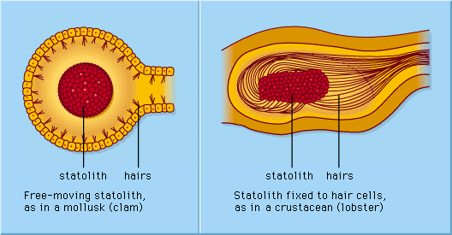
Mechanoreceptors
Detect body position through touch, pressure, gravity, stretch and movement
Statocysts detect gravity

Slide 10
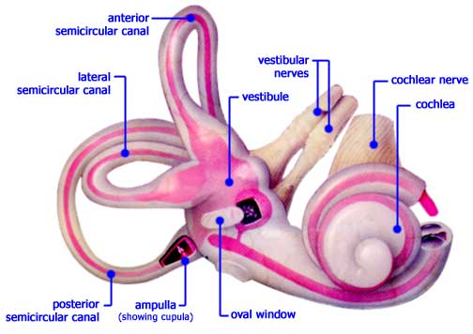
Human inner ear

Slide 11
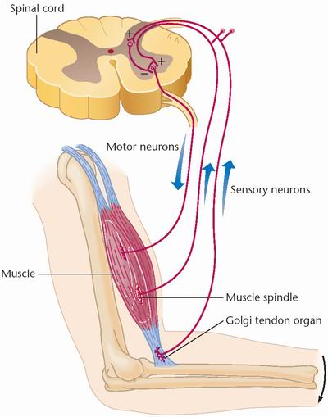
Proprioceptors detect stretching in muscles and tendons to let you know where your limbs are.

Slide 12
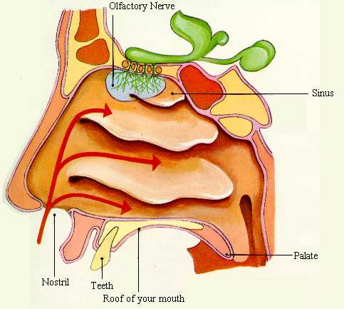
Chemoreceptors
Human olfactory organ

Slide 13
Human Taste Receptors
The following slide shows what was once thought to be the main areas where we detect the 4 main tastes. This is now considered to be inaccurate. We have taste buds all over out tongues to detect all of these tastes as well as another taste called umami which is described as “meaty” or “brothy”.

Slide 14
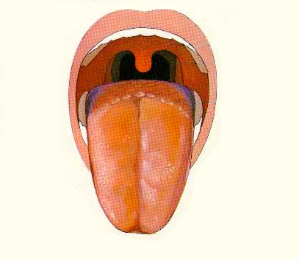
Human taste
Bitter
Sour
Sour
Salt
Salt
Sweet

Slide 15
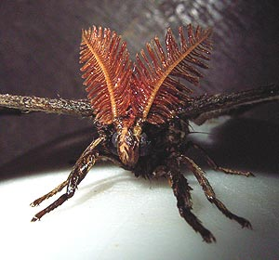
Male moths use their feathery antennae to detect females many km away

Slide 16
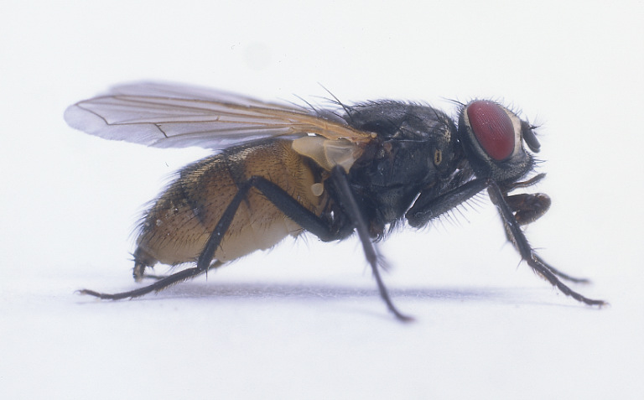
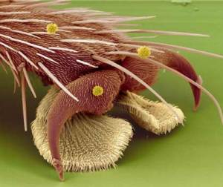
Flies feet smell – no not foot odour – they have chemosensory hairs that taste or smell the surface they are on

Slide 17
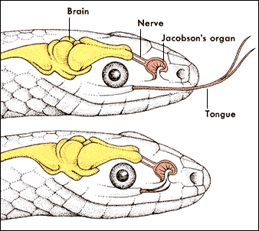
Snakes have a “Jacobson’s organ” into which their tongue is inserted after sampling the air.

Slide 18

Animals can gain valuable information using their chemosenses

Slide 19
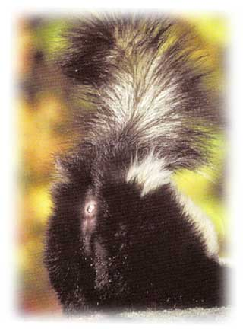

Find prey
Detect predators
Check food
Recognise others
defence
Mark territory
Communication
Sexual attraction
Alarm signals
Make a trail (e.g. ants)

Slide 20
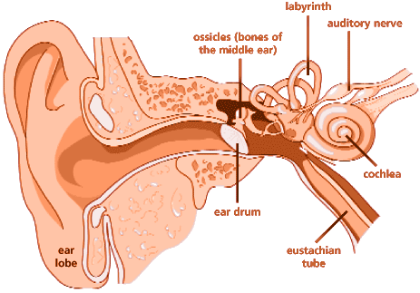
Hearing
The human ear can hear from 20 to 20 000 Hz

Slide 21
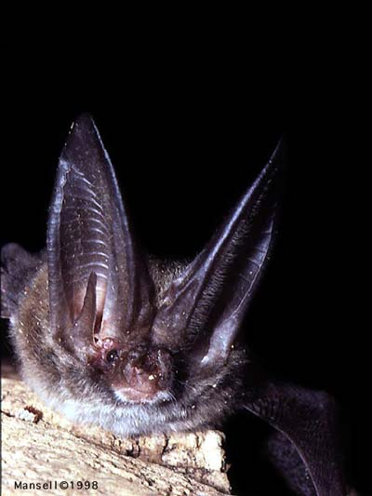
Bats can hear up to over 80 000 Hz (ultrasonic) and use echolocation

Slide 22

Dogs’ range is 40 Hz to 60000 Hz

Slide 23
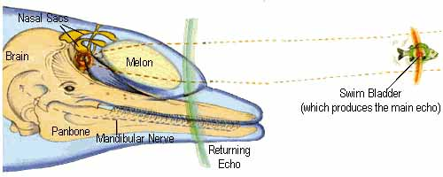
Dolphins and other cetaceans use sound for echolocation

Slide 24
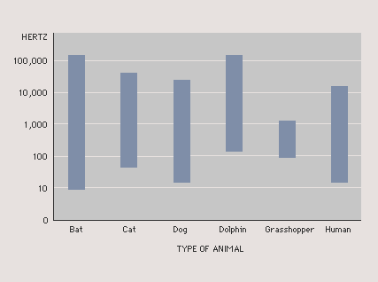
A few more ranges

Slide 25
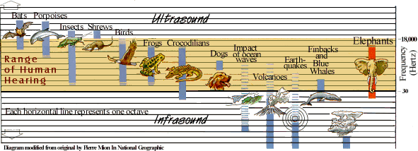
Infrasound
Animals such as whales and elephants use deep infrasound to communicate over long distances

Slide 26
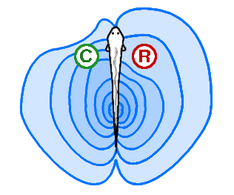
Electric field detection
Many fish can detect electric fields. Some produce their own field and use it to detect objects around them. Conductors (e.g. animals) distort the field differently from resistors (e.g. rocks)

Slide 27
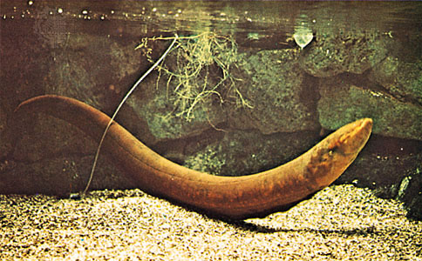
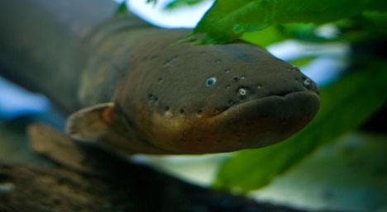
The electric eel

Slide 28
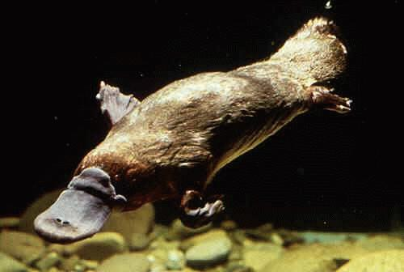
The platypus detects the tiny electric output of its prey such as shrimps.

Slide 29
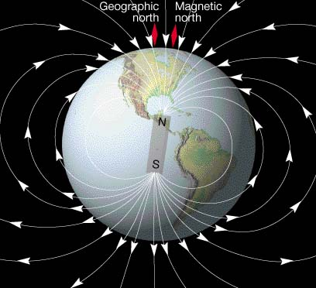
Magnetic field detection
The Earth has a magnetic field

Slide 30
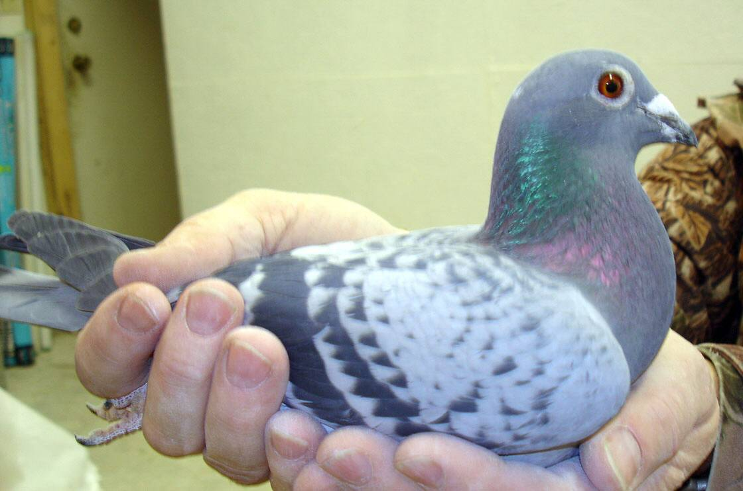
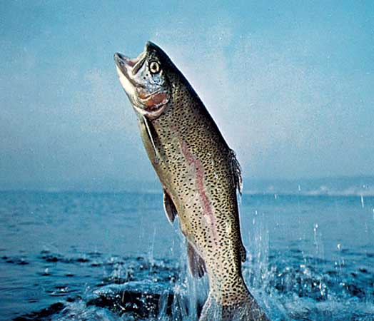
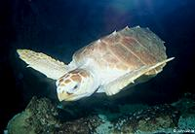
Animals such as pigeons, turtles and trout use Earth’s magnetic field to navigate.
Te Mutu

